Slide 1
last UPDATE
1.3.8
Changed:
Moved the custom infection time into the "other" category
Reworked the visuals of the modpage ! Hope you like those ;)
Added:
Added new sandbox options to customize the infected speed min and max for each area (top, middle, bottom)
Explaination of the custom infection system on the workshop page
Fixed:
Infection system so it takes the minimal infection time from a zombie infected wound and every other infected parts reduce that infection timer by 5%
CLICK to check past PATCH NOTES

Slide 2
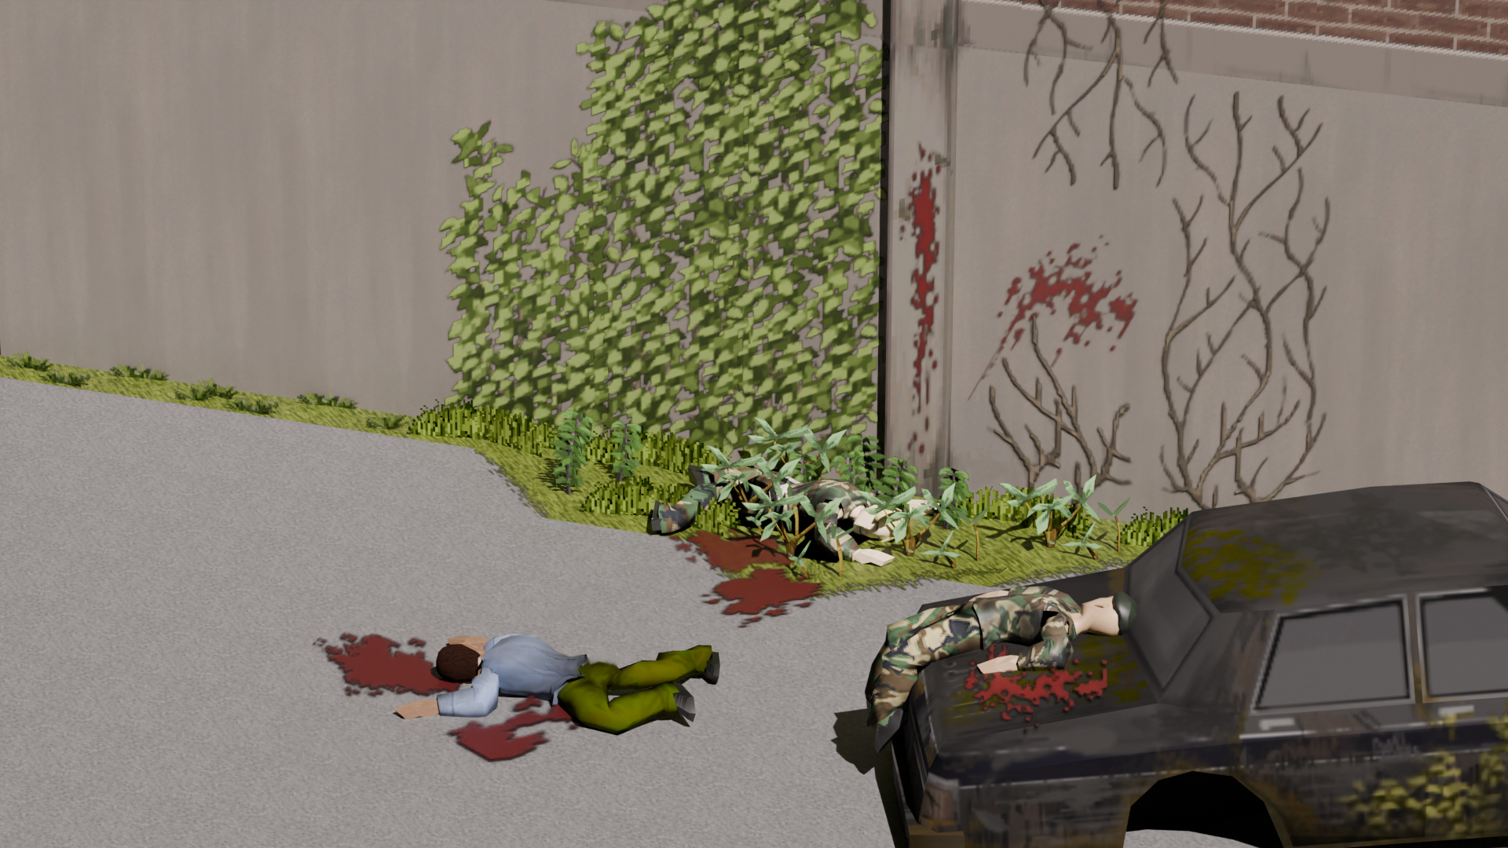
Fight the infected of The Last of Us thanks to this mod. The goal is to make zombies of Project Zomboid harder with new mechanics to not have the need for massive population amounts just to have some difficulty in the game.

Slide 3
Suggested settings
Set your population to a low number ! Test your population settings, don't hesitate to lower them down, I myself set it to an even lower value !
Green apocalypse settings (10 Years Later, no electricity, no water, Barricaded World, rare loot...).
Small tips
Sprinters but can be slowed down by using mods that slow down sprinters
You can tweak the infected types weights in real time to make the infected population increase across time.
Fire is much more powerful against the infected than normal zombies or fresh infected (runners). It is more than a horde clearing tool but an actual weapon that can make Clickers and Bloaters a walk in the park (sort of).

Slide 4
Runners are humans recently infected by the Cordyceps fungus. They can quickly overwhelm you with their sheer speed and numbers but are exposed to attacks from weapons. You may hear them talking and struggling from within, with the soul of the host likely still present but unable to control their body.
Runners behavior
Tend to be in groups in the street, compared to other infected type that will hide inside buildings
Sprinters*
Can climb small fences*
Have normal human strength* and toughness* meaning they are fragile against attacks
The number is their strength, do not take them too lightly
Have medium vulnerability to fire*
* can be modified in the sandbox options

Slide 5
Stalkers evolve from Runners with the Cordycep fully taking over the host's body. They are tougher and stronger than simple Runners, often ambushing you by hiding inside buildings. The human inside likely lost the battle against the fungi, and its cries of struggle are slowly being replaced with a distinctive clicking noise.
Stalkers behavior
Will hide inside buildings*
Sprinters*
Can climb small fences*
Have a stronger than normal toughness and strength
Have high vulnerability to fire*
* can be modified in the sandbox options
Stalkers visuals
Will have ragged clothings, half bloody and dirty

Slide 6
Clickers evolve from Stalkers into an even more dangerous state. Their inhuman strength makes them extremely perilous to approach; anyone too close could find themselves dead in mere seconds. The cries of struggle have long been replaced with a clicking noise, used to replace their lost eyes due to the Cordyceps eating through them. Fortunately, this alteration makes them slower than simple Runners and Stalkers. However, they will move in unpredictable ways their arms, catching you whenever they get close enough to you.
Clickers behavior
Will hide inside buildings*
Can climb small fences
Move slowly when have no targets but will rush towards their target
Have inhuman strength and toughness. They will overpower you and one shot you*
Have bad vision (Not blind yet, this will be worked on in future updates)
Have higher HP* and should survive around 2 shotgun shells
Have high vulnerability to fire*
Will take increased damage when set on fire*
Cannot be pushed with hands*
Will grab you* (off by default)
* can be modified in the sandbox options
Clickers visuals
Will have ragged, bloody and dirty clothings
Custom model: 2 models with each 2 textures variations
Custom animations (WIP)

Slide 7
Bloaters are seen as legends by many due to their rarity among infected types. If a Clicker manages to survive over the years, sustaining its body and the Cordycep within, it evolves into a colossus with thick skin protected by Cordyceps patches. No one wants to contemplate what would happen to a person if they were caught by this creature, so approaching it is out of the question.
Bloaters behavior
Will hide inside buildings*
Can climb small fences
Fast shamblers
Have inhuman strength and toughness. They will overpower you and one shot you
Have bad vision
Have higher HP* and should survive around 20 shotgun shells
Have high vulnerability to fire*
Will take increased damage when set on fire*
Can take down structures quickly
Cannot be pushed with hands
Will grab you
* can be modified in the sandbox options
Bloaters visuals
Custom model

Slide 8
Different infection type based on the area infected (top, middle, bottom)
Doesn’t affect the type of transmission, meaning you can set it to blood + saliva, saliva only and it will be taken into account
Ignores the infection mortality
Sandbox option available to deactivate it or customize infection time
Every new infected parts on an area decreases the infection time by 5%

Slide 9
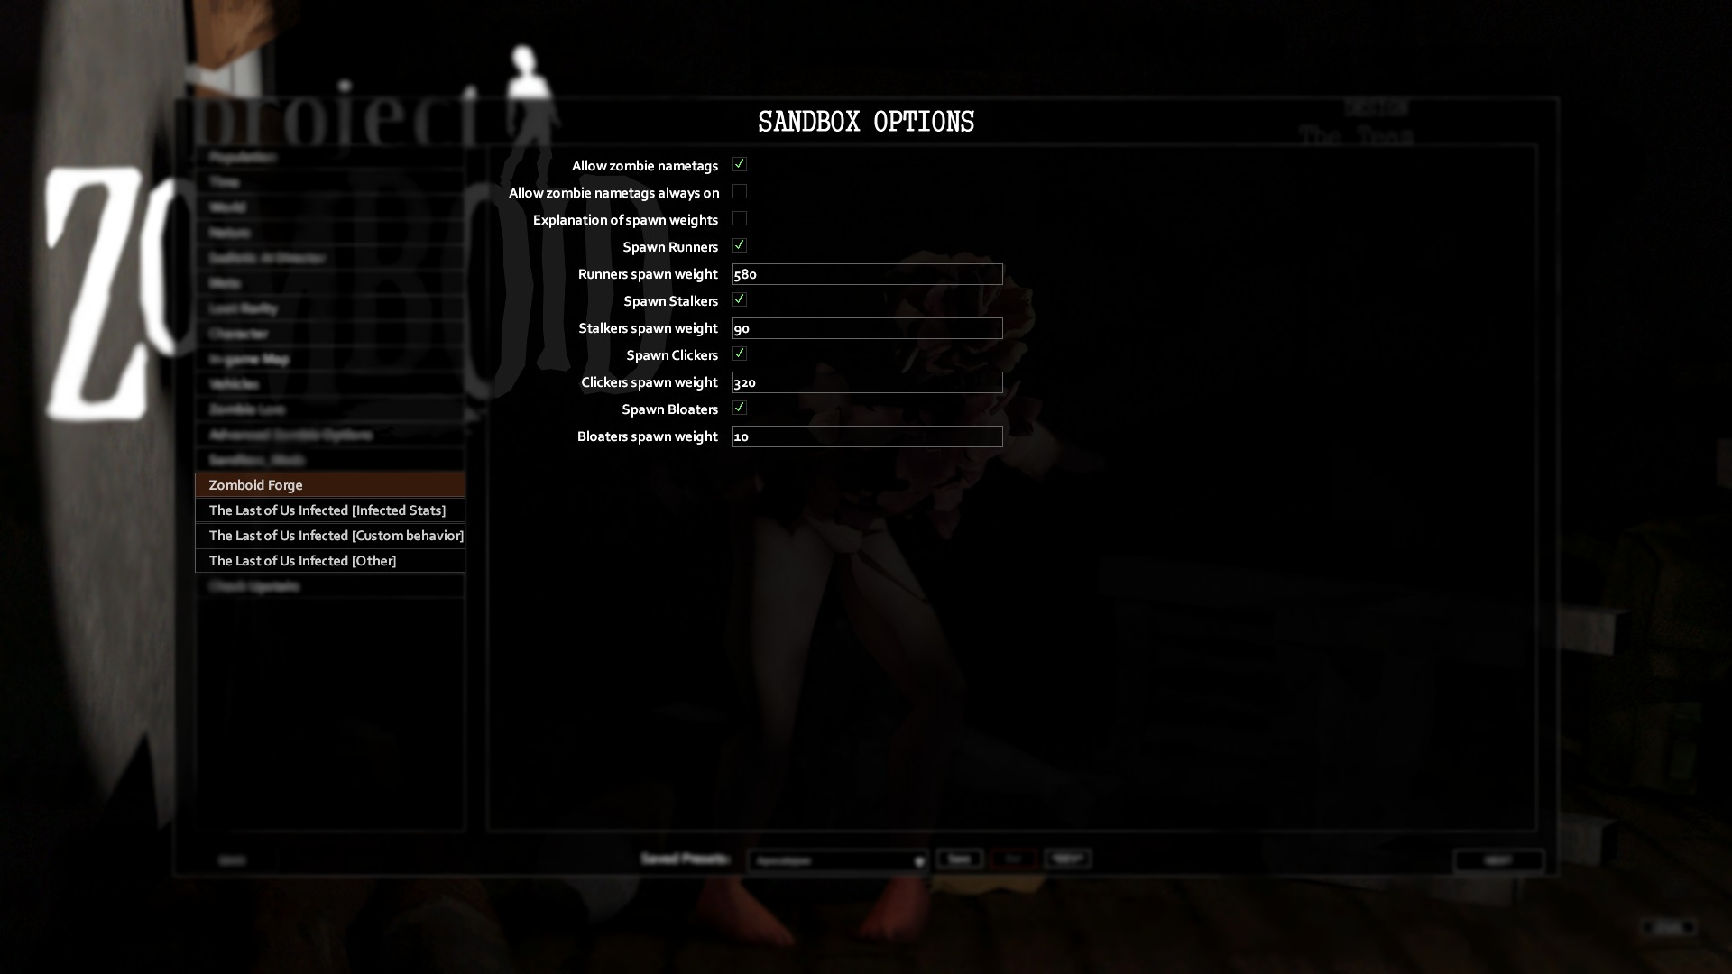
Allow nametags always on for players
Allow nametags for players
Read it if you don’t understand the weight system !
Control spawnrate for each infected types
Change stats of the infected

